Slide 1

HR Compensation Analysis
Workforce Planning for 2019 & Beyond

Slide 2


Objective & Aims
Increase company revenue to $1B by:
Growing book of business
Equitable commission structures
Optimal workforce numbers

Slide 3
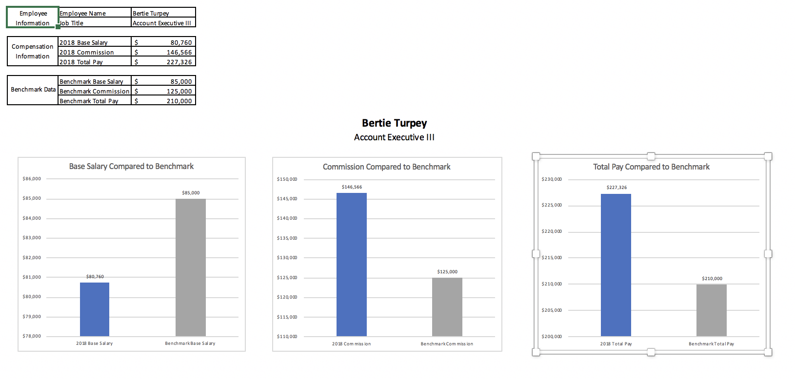
Sales Employee Performance vs. Benchmark
Analyze results at employee level. Comparing:
Base Salary
Commission
Total Pay

Slide 4
Strategy 1
Assume consistent compensation structure and no growth in headcount.
34% increase

Slide 5
Strategy 2
Modify the pay structure to boost incentives for employees & maximize net revenue.
10% increase

Slide 6
Strategy 3
Increase the headcount.
20% increase

Slide 7
Results
Strategy 1 – highest net revenue increase
Combination of all three strategies
65% increase
Strategy (Combined)
1,200
$ 1,116,101,518
$ 840,000,000
132.9%
30,000
$ 37,203
$ 930,085
$ 90,734,481
$ 146,073,168
$ 4,869
$ 236,807,649
$ 879,293,868
$ 732,745

